Slide 1
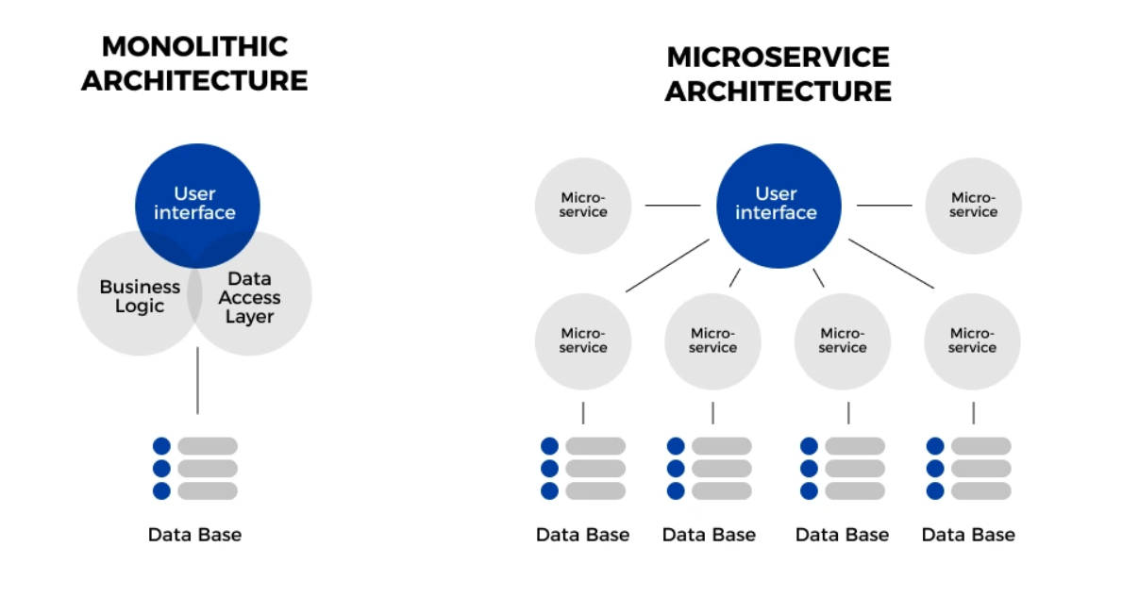
The Pros and Cons of a Monolithic Application Vs. Microservices
For a long time, monolithic architecture has been the standard when it comes to application development, but as the digital economy moves to a more subscription-based model, it’s starting to look out-dated.

Slide 2
Many companies are instead turning to microservices architecture for their application needs. Amazon AWS, for example, has already adopted this, citing flexibility and ease of deployment as key benefits.
What does all this mean for you and your business? In this guide, we’ll illuminate the key features, benefits, and limitations of each architecture to help you navigate the new microservices era.

Slide 3
What is a monolithic application?
Monolithic systems are constructed in a single block (otherwise known as a “monolith”). A monolithic application is thus built and will function as one entity, with things like APIs, databases, services, and load balancers woven into a single application framework.
Microservices, meanwhile, take each aspect of an application and break it up into independent services, which communicate via APIs. Individual teams are usually responsible for each service.

Slide 4
Monolithic vs. microservices
When it comes to monolithic architecture vs. microservices, it’s tempting to assume that what’s newer is better. However, the monolithic application vs. microservices question is a bit more complicated than just old vs. new.
Depending on what you need, either monolithic or microservice architecture could be the key to unlocking your organization’s potential.
Let’s take a closer look at their comparative advantages and disadvantages.

Slide 5
Advantages of monolithic architecture
A good monolithic web application has a lot of advantages. Here are just a few:
Simple deployment
Monolithic technology is not as complex as microservice technology. Monolithic applications have fewer moving parts, so there are fewer components to manage and fix together.
All in all, the self-contained nature of a monolithic app makes it easier to deploy, manage, and maintain than a microservices solution.

Slide 6
Advantages of monolithic architecture
Easy to develop
If you want to develop an entire application and get it to market quickly, monolithic architecture has a lot of advantages.
It’s easy for a small team to rapidly pull together and build an executable app using a monolithic system. This makes monolithic architecture ideal for startups without big software development budgets.

Slide 7
Advantages of monolithic architecture
Uncomplicated testing and debugging
Testing and debugging plays a big part in the monolithic architecture vs. microservices debate.
With microservices, you have to test all parts of the applications separately, from the software architecture to things like caching, dependencies, data access, and more. Then you have to test that all these disparate services fit together properly. It’s expensive and time-consuming.
That’s not a problem with monolithic architecture software. Because the application is fitted as a single unit and works together as a whole, you can do everything quickly and easily from a central logging system.

Slide 8
Limitations of monolithic architecture
It sounds good so far, right? Well, don’t make your mind up just yet. A monolithic service may not be right for you if the following would pose an issue:

Slide 9
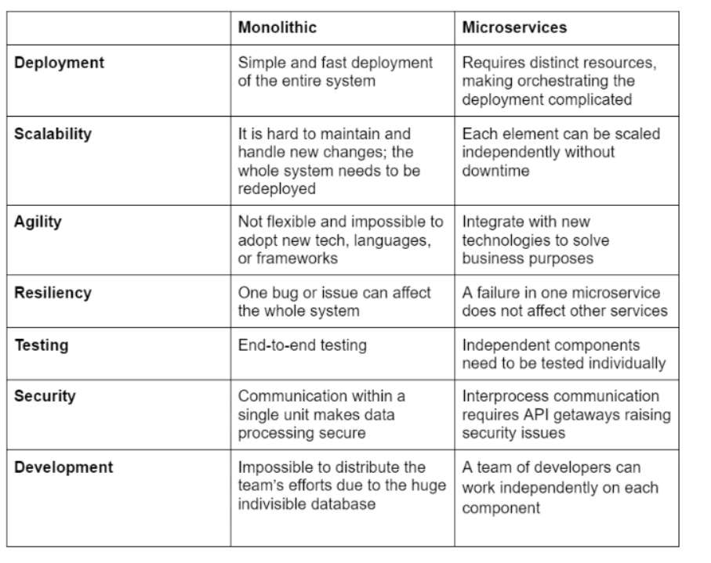
Limitations of monolithic architecture

Slide 10
Limitations of monolithic architecture
Less scalability
Because monolithic architecture software is tightly coupled, it can be hard to scale. As your codebase grows and/or you want to add new features, you need to drag the entire architecture up with you.
Even if you only want to boost or alter a single function, the entire application needs changing. This isn’t just time and resource-consuming but can also disrupt your continuous delivery.

Slide 11
Limitations of monolithic architecture
Inability to adapt to new technologies
As mentioned, monolithic applications are tightly coupled. Take a music app, for example. The catalog is connected tightly to the purchase and play services. This means it’s hard to bring in new technologies or web services without dismantling the entire app.

Slide 12
Limitations of monolithic architecture
High dependence between functionalities
Because of the tight dependency we mentioned above, monolithic applications can run into software engineering and downtime difficulties.
Let’s go back to that music app example. Because the catalog, play, and purchase functions are so dependent upon one another, if one goes down, it takes the others with it.
People may not want to buy new music but just listen to the tracks already in their catalog. However, if the purchase function goes south, the whole monolithic app could be functionally useless until the issue is fixed.

Slide 13
Advantages of microservices
Microservices have a lot going for them. Here are a few of the reasons why many companies rely on them to boost their business capabilities:

Slide 14
Advantages of microservices
Independent services
In a microservice context, each service is developed independently of the others and the business logic is spread over various platforms. This means workflows for one service won’t affect the development of another, and resources like development tools aren’t dependent on irrelevant functionalities.
Instead, each service gets the full attention of its own team, enabling quick and efficient independent development. Then it’s just a case of coupling services together.

Slide 15
Advantages of microservices
Enables agile development
As each service is developed independently, you can choose the tech stack and programming language that best suits each function. This means you can use the best tools for each particular service, rather than taking the one-size-fits-all approach you’re forced to use for monolithic software architecture.
This kind of agility means applications can be developed quickly and efficiently.

Slide 16
Advantages of microservices
Scalable & reliable
We’ve spoken about how monolithic technology can be hard to update and scale. That’s not the case with hybrid cloud microservices. Because of each function’s loose coupling, it’s easy to optimize, test, debug, and fix functions independently of one another.
Rather than putting the whole app into downtime and scaling each service, you can instead tweak and upgrade independent services as and when needed.
This loose coupling makes microservice architecture reliable. One crashed service doesn’t bring down the entire app. If something goes wrong with an API gateway, the others can still operate independently.
So, to return again to that music app example, even if the purchase and download function crashes, customers could still access the user interface and play the music they already own.

Slide 17
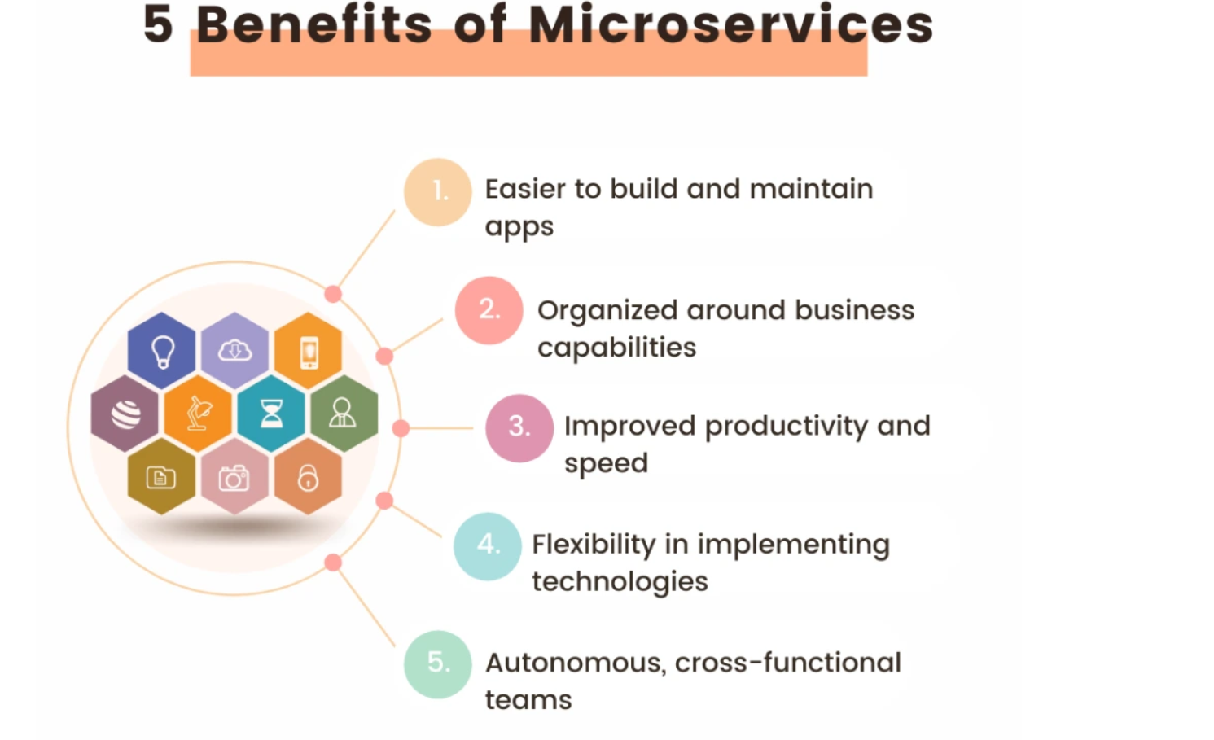
Benefits of Microservices

Slide 18
Limitations of microservices
Just like monolithic architecture, microservices have disadvantages too. Here are the most noteworthy:
Time and resource-consuming
While the autonomy of each microservice can speed up development, it can also slow it down. It all depends on how complex you want to make your app.
That’s because developing an individual microservice is usually quicker and more efficient than developing the same service in a monolithic context. Regardless, implementing lots of different microservices and then having to put them all together can take a substantial amount of time.
On a similar note, while microservice architecture allows you to use the optimal tools for each service, putting individualized tech stacks together can require a lot of resources.

Slide 19
Limitations of microservices
Complicated deployment
Once you’ve developed each microservice, they need to be integrated into a functional app before they can be deployed. This can be a complicated process.
For a start, cross-cutting (in which each microservice needs validation or authorization to proceed) can be a problem. With monolithic architecture, the tight coupling means an authorization for one service usually translates to authorization across the board. That’s not automatically the case for microservices, and making it so can require complicated linkage work.
All in all, deploying a microservice architecture isn’t always easy, and it gets harder the more complex your app is.

Slide 20
Limitations of microservices
Complex testing
Every service in a microservice application has to be tested individually. Once all the individual service tests have been completed, you need to test how they work as a whole.
It’s important to test before releasing any product to market (and then to run regular functionality tests for as long as the product remains in circulation). If you want these tests to go quickly, a microservice model may not be for you.

Slide 21
Monolithic application examples
A typical monolithic architecture application has a front-end user interface, a server-side interface, and a codebase (software-supporting database).
If your needs are simple and you need a quick turnaround, monolithic is the obvious choice. Here’s an example.
You’re a startup with a lot of great ideas but not a lot of resources. To launch your business, start scaling, and attract the attention of investors, you need to get your product to market as quickly as possible.

Slide 22
Monolithic application examples
In this case, monolithic architecture is your friend. You can put an app together rapidly and without too much drain on your resources. There will be plenty of time to optimize and improve things as you scale, but monolithic architecture allows you to get your business up and running in good time.
Monolithic architecture is also a wise choice when your product isn’t too complex and won’t need a lot of future scaling. You can keep things simple and cost-effective without sacrificing quality.

Slide 23
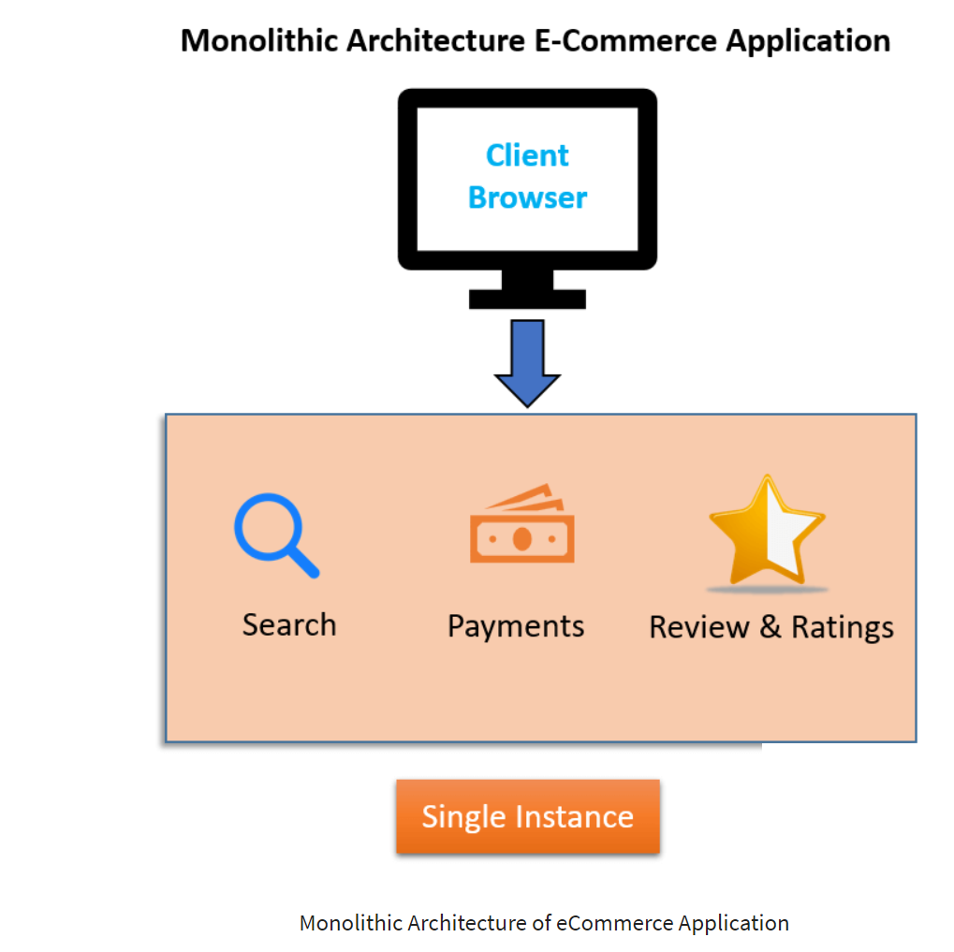

Slide 24
Microservices examples
Microservices have a lot of applications, but a common one is the restructuring of legacy systems.
Let’s say you’re a well-established company with an unwieldy legacy system. You want to modernize, move systems to the cloud, change certain functionalities, or just generally improve your digital systems.
In this case, microservices help you to optimize and improve incrementally, without too much downtime or expending too many resources at once.
Microservices are also useful if you need to stream and process a lot of data in real-time. Streaming services, online banking, and eCommerce applications all need to handle a lot of real-time data quickly and efficiently. Microservices are far more capable of handling this kind of data load than monolithic applications.

Slide 25
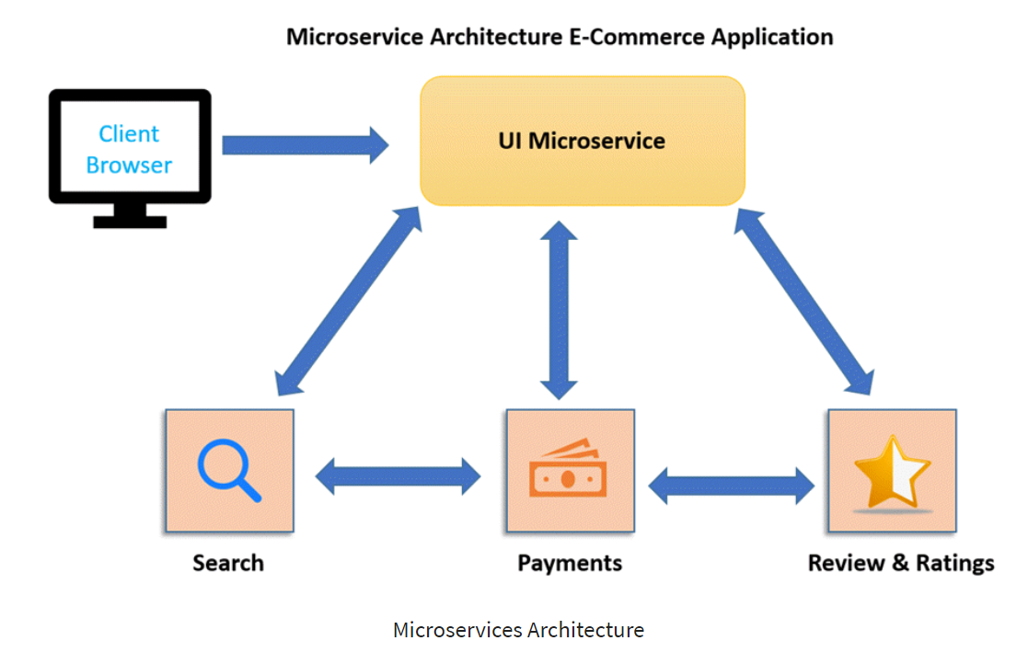

Slide 26
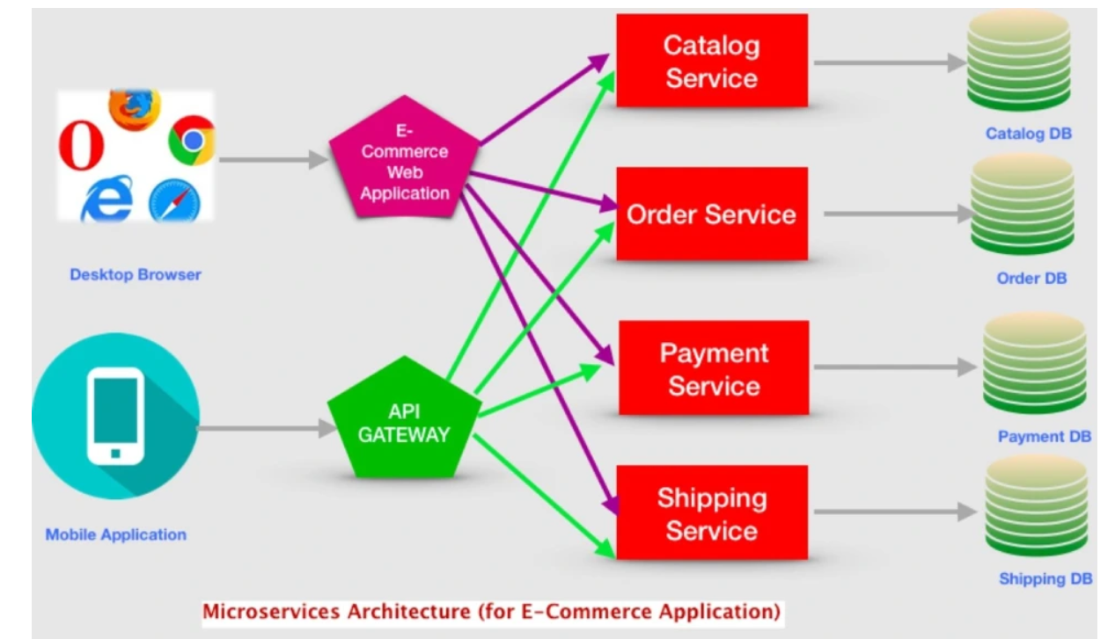
Microservices Architecture

